Slide 1

SECRET KNOCK DETECTION SYSTEM
M Siva Yogitha (CB.EN.U4CSE15334)
Ramachandra Gopal (CB.EN.U4CSE15342)
Sourav Rajeev (H2)
Under the guidance of:
Guide name: Mr.Ananthanarayan
Designation: Professor
15CSE480 – Final Review
Department of Computer Science & Engineering Amrita School of Engineering, Coimbatore
1 / 19

Slide 2
Problem Statement
The projects idea is to build a knock detecting door lock that can identify specific knocking pattern and unlock the door if the pattern is correct.

Slide 3
Introduction
Security is a major concern in our day to day life, and digital locks have become an important part of these security systems. There are many types of security systems available to secure our place. One such system is SECRET KNOCK DETECTION SYSTEM, which can detect the pattern of your knocks at the door and will only open the lock if the knocking pattern matches with the correct pattern.

Slide 4
Introduction (contd..)
This, system provides more security than the systems we are currently using. When there are many users who use the door, problem may occur because there is only one key to the door.
But, in this system, this problem may not arise because the users who know the knocking pattern can open the door any time without a key.

Slide 5
Related Works / Literature Survey / Current Status
S.No | Title | Publication Details | Comments/ Inferences
1 | Security System Based on Knock-Pattern Using Arduino and GSM Communication | International Journal of Engineering and Techniques - Volume 4 Issue 1, Jan – Feb 2018 | The issue of safety is being addressed through easily and affordable technology like piezo sensor, GSM module, Push button, and Arduino microcontroller.
2 | ARDUINO Based industrial security system using piezo electric sensor | IEEE Projects 2014-2015 | The arduino controller based digital lock presented here is an access control system that allows only authorized persons to access a restricted area.

Slide 6
Design ( HW / SW ) / Architecture…
HARDWARE
Push Button
Peizo Sensor
1M Resistor
Arduino UNO
Battery
Connecting wires
Box
Servo Motor
SOFTWARE
Ardunio IDE
LAMP Server
ARCHITECTURE:
The secret code should be fed into the system first. This system is mainly based on the time difference between the knocks. The push button can be used for this purpose. We press and hold the button until we knock the number of times we want to knock.
Notes:
Mininet is a network emulator which creates a network of virtual hosts, switches, controllers, and links. Mininet hosts run standard Linux network software, and its switches support OpenFlow for highly flexible custom routing and Software-Defined Networking.
ns-3 is a discrete-event network simulator, targeted primarily for research and educational use
OMNeT++ is an extensible, modular, component-based C++ simulation library and framework, primarily for building network simulators. "Network" is meant in a broader sense that includes wired and wireless communication networks, on-chip networks, queueing networks, and so on.

Slide 7
Architecture(Contd)…
After knock, Arduino find the knock pattern and save that in EEPROM.
Now after saving the input pattern, press the push button for taking input from the sensor to Arduino to open the lock .
Now we knock the right pattern. Arduino decodes it and compares with saved pattern.
If a match is found, then an OTP will be sent to all the registered admins’ phone numbers.
Then the admin who knocked the door should sign into the website and approve to open the door .
Then the log is updated in the webserver and the Arduino opens the door by driving servo motor .
Other admins’ need not approve. If no one approves within a specified time limit, it is logged as failed attempt in the web server .

Slide 8
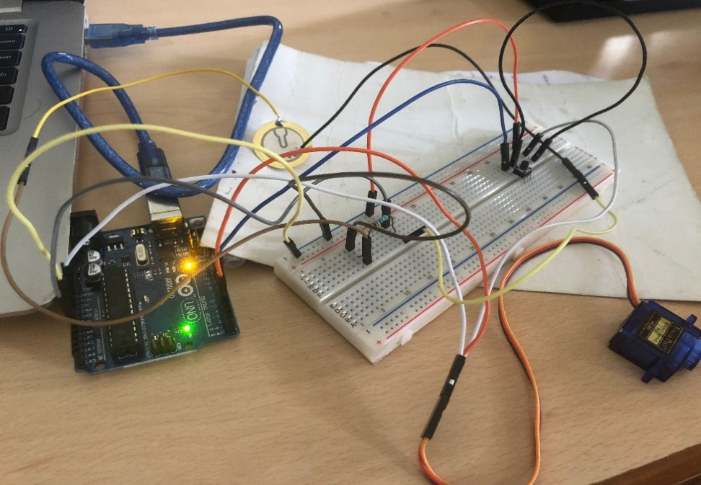
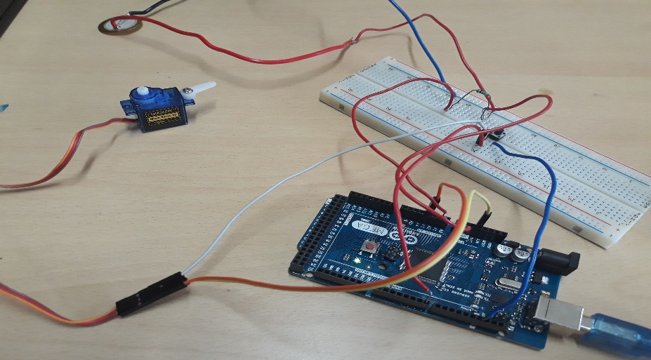
Screen shot of Hardware setup

Slide 9
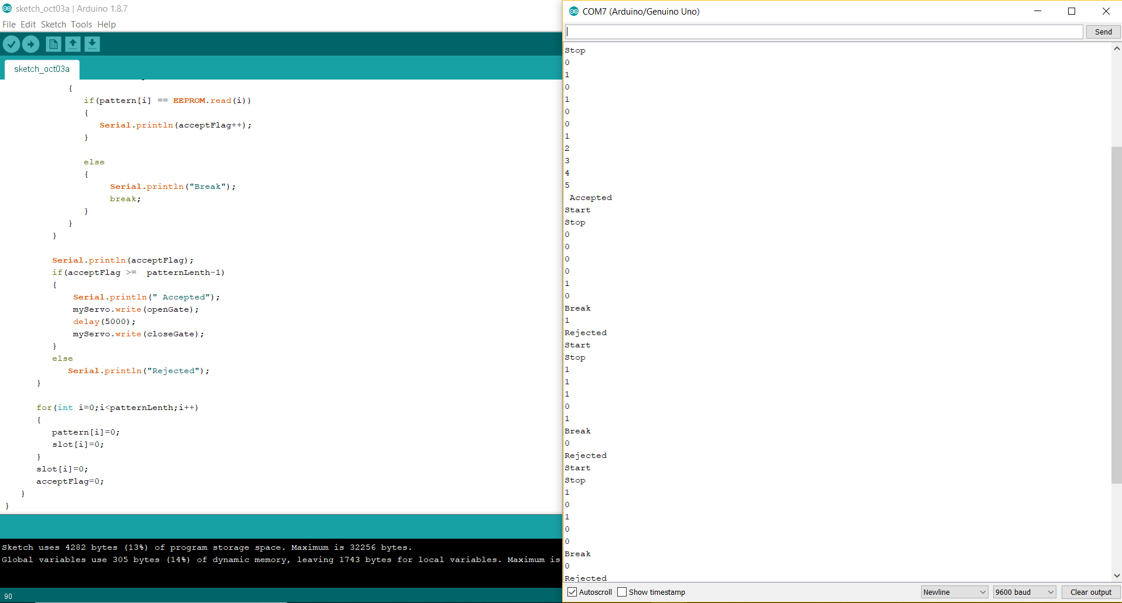
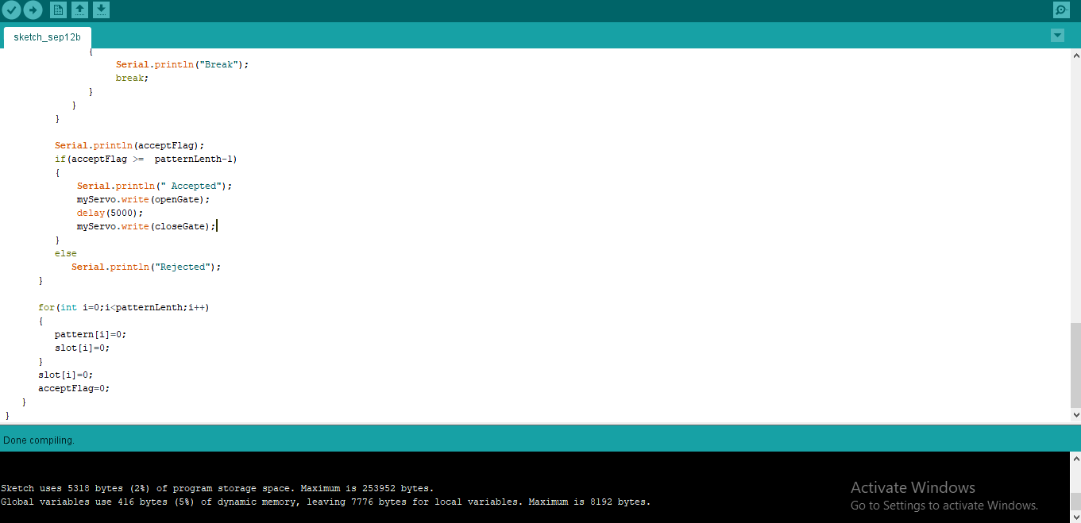
Screen shot of Application Software screenshots

Slide 10
Outcomes of Project
The piezo sensor identifies the absolute time difference between the knocks and unlocks the door if the it matches the secret sequence and finally if approval of either of the admins is made.

Slide 11
Conclusion and Future Work
In this generation of advanced technology, theft and crime has taken the aid of technology itself in achieving its results many times. To avoid such circumstances, sometimes even small things can lead to a great change. Thus, implementation of smart devices in Security Control like the Knock Based Security System can prove to be very valuable to the person using it and also to the valuables themselves.
This can also be improved by interfacing with various technologies like finger print reader, voice detection etc., thus making it much more secure while not being too costly and out of reach in terms of availability.

Slide 12
References
https://en.wikipedia.org/wiki/Touch_switch
https://en.wikipedia.org/wiki/Servomotor
https://store.arduino.cc/usa/arduino-mega-2560-rev3
https://www.instructables.com/id/Secret-Knock-Detecting-Door-Lock/
https://circuitdigest.com/microcontroller-projects/secret-knock-pattern-detecting-door-lock-arduino

Slide 13
Thank You

